Slide 1


­Recent Developments in
Unified Mechanics Theory
Prof. Dr. Cemal Basaran
University at Buffalo
The State University of New York
Institute of Fundamental Technological Research
Polish Academy of Sciences
Monday, April 24, 2023

Slide 2
Presentation Outline
I- Objective
II- Introduction
III- Literature
IV- Theory
V- Validation
VI- Conclusions

Slide 3
Objective
Establishing the laws of nature governing, behavior of inorganic and organic materials/structures during their lifetime, without the need for empirical models based on curve-fitting to test data.

Slide 4
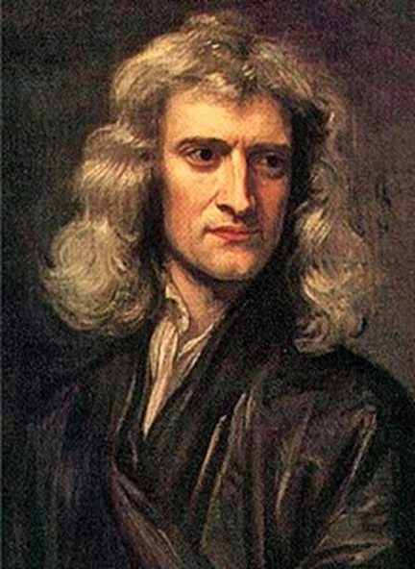
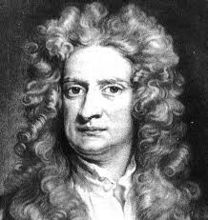
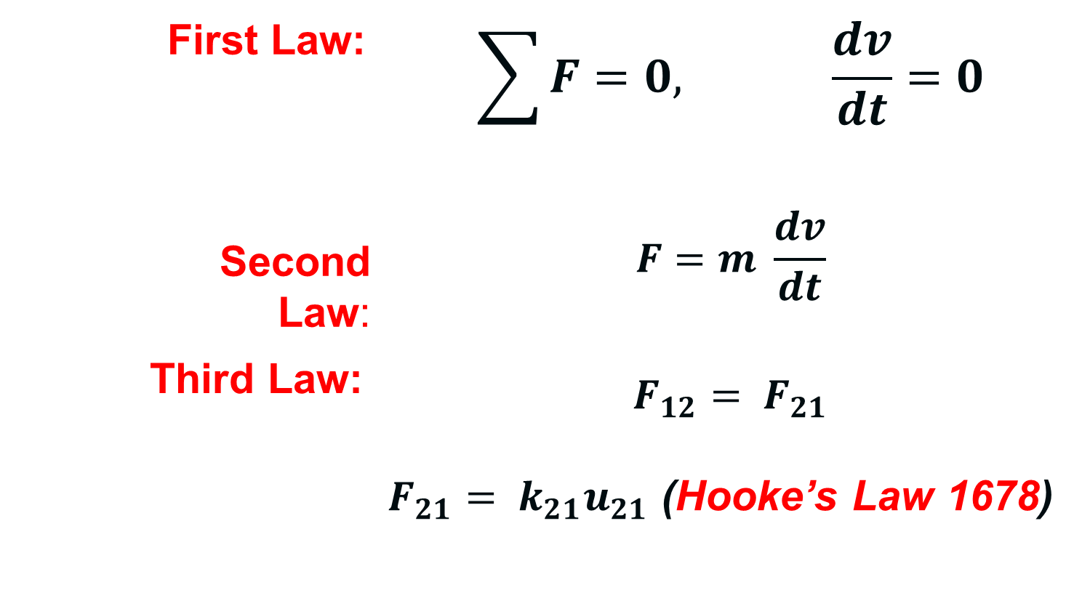
Newtonian Mechanics
Sir Isaac Newton’s work in “The Principia,” 1687
First Law: | $$\sum{F=0, \frac{dv}{dt}=0}$$
Second Law: | $$F=m \frac{dv}{dt}$$
Third Law: | $$F_{12}= F_{21}$$ $F_{21}= k_{21}u_{21}$ (Hooke’s Law 1678)

Slide 5

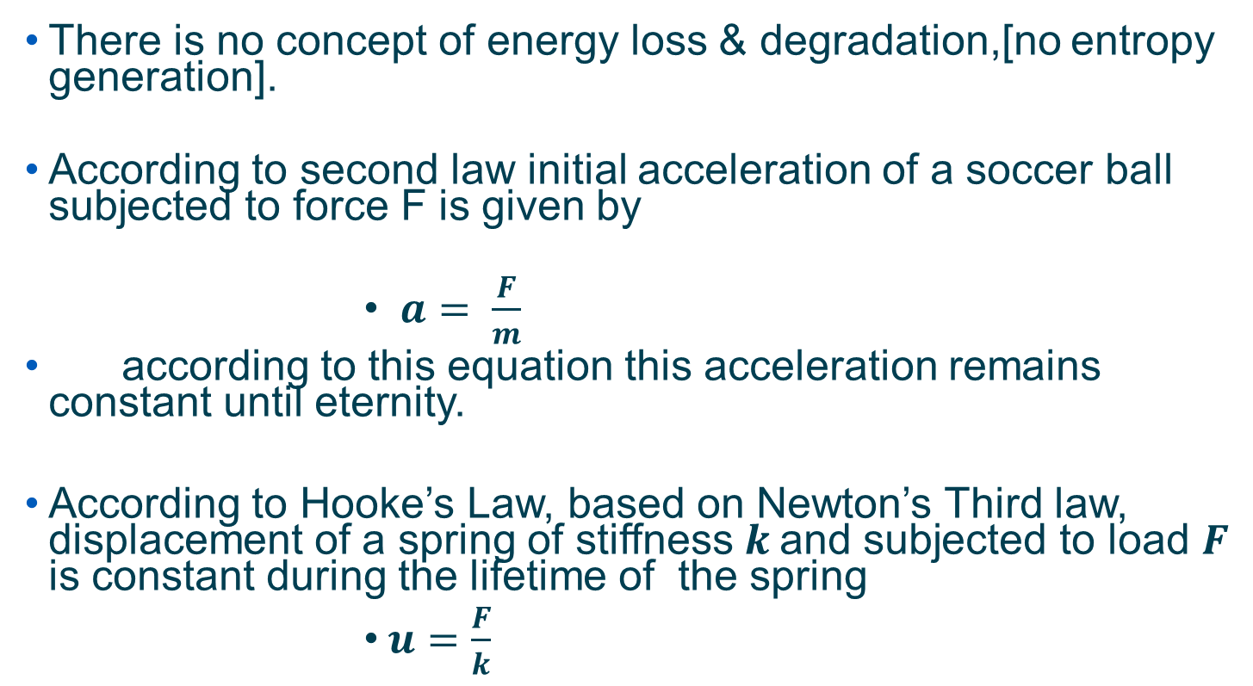
Understanding Newton’s Laws
There is no concept of energy loss & degradation,[no entropy generation].
According to second law initial acceleration of a soccer ball subjected to force F is given by
              $a= \frac{F}{m}$
according to this equation this acceleration remains constant until eternity.
According to Hooke’s Law, based on Newton’s Third law, displacement of a spring of stiffness $k$and subjected to load $F$ is constant during the lifetime of the spring
              $u=\frac{F}{k}$

Slide 6
Laws of Thermodynamics in 1850 Rudolf Clausius and William Thompson (Lord Kelvin) formulated 1st and 2nd Laws
First Law : Conservation of energy.
Second Law:
1- In a natural process, the entropy (energy lost to unintended work) of an isolated/closed system never decreases. Entropy generation rate is minimum, and entropy is maximum when the system reaches “The End” of predefined process.
2- There is a natural tendency of any isolated/closed system to degenerate into a more disordered state.

Slide 7
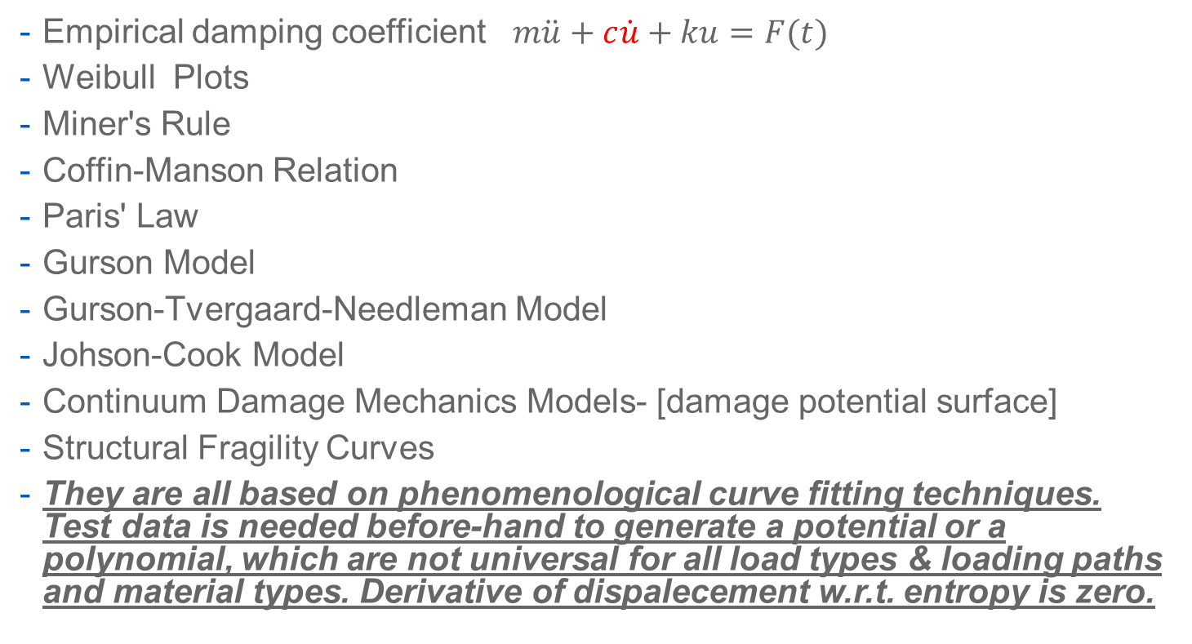
Traditional Methos to Introduce
Thermodynamics into Newtonian Mechanics
Empirical damping coefficient $m\ddot{u}+c\dot{u}+ku=F(t)$
Weibull Plots
Miner's Rule
Coffin-Manson Relation
Paris' Law
Gurson Model
Gurson-Tvergaard-Needleman Model
Johson-Cook Model
Continuum Damage Mechanics Models- [damage potential surface]
Structural Fragility Curves
They are all based on phenomenological curve fitting techniques. Test data is needed before-hand to generate a potential or a polynomial, which are not universal for all load types & loading paths and material types. Derivative of dispalecement w.r.t. entropy is zero.

Slide 8
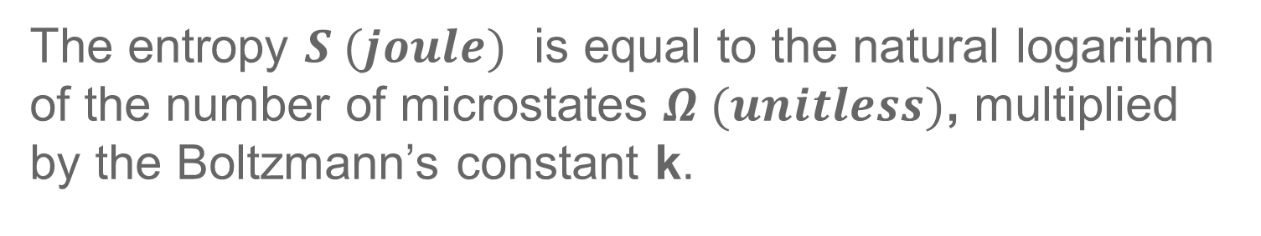


What is Entropy?
Entropy =𝑫𝒊𝒔𝒐𝒓𝒅𝒆𝒓≡ Energy lost to unintended work (dissipation/degradation, etc.). It can be created, but cannot be destroyed.
Energy unavailable for intended work
(Joule)
Disorder
$$s=k \ln{Ω}$$
The entropy $S (joule)$ is equal to the natural logarithm of the number of microstates $Ω (unitless)$, multiplied by the Boltzmann’s constant k.

Slide 9
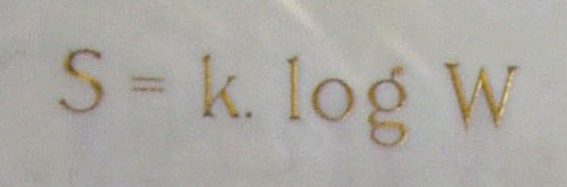
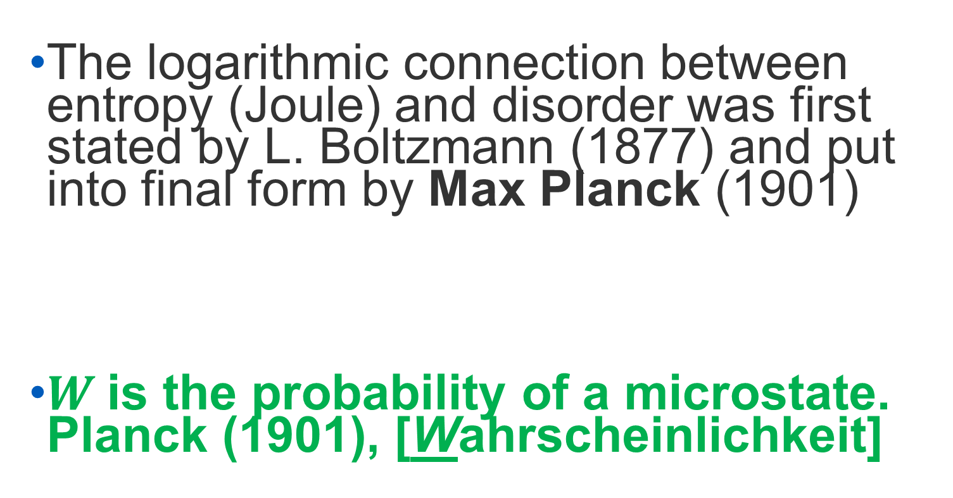
Relation Between Entropy and Disorder
The logarithmic connection between entropy (Joule) and disorder was first stated by L. Boltzmann (1877) and put into final form by Max Planck (1901)
$W$is the probability of a microstate. Planck (1901), [Wahrscheinlichkeit]

Slide 10
Boltzmann’s Formulation is NOT Restricted to Gases.
Boltzmann formulates his hypothesis for an arbitrary material.
Derivation yields an upper bound value of number of possible microstates. Gas can have larger number of microstates than solid or fluid. Material constitutive relation determines the number of possible microstates.
For mathematical proof, please see
Cemal Basaran, Introduction to Unified Mechanics Theory with Applications, Springer, 2nd edition, 2023.

Slide 11
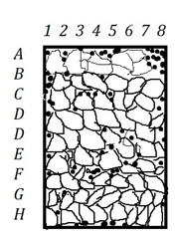
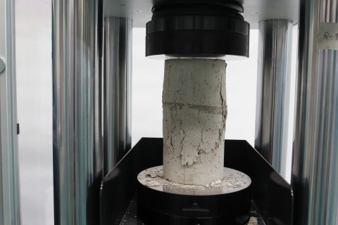
What is Damage/Degradation?
Ref: https://www.prodyogi.com/how-to-test-compressive-strength-of

Slide 12
What is Damage/Degradation?
There is no damage at the atomic scale. When you die your atoms don’t die.
“Damage” is disorder which is relocation of atoms.
New location of atoms is disorder with respect to their initial lattice configuration.
Evolution of disorder is governed by laws of thermodynamics.

Slide 13
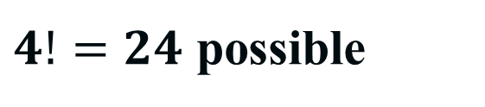
What is Entropy in Boltzmann’ formulation?
A
B
C
D
A
B
D
C
$4!=24$ possible
Description of
(a) order (reference state) (b) disorder
If two atoms are connected like a in solid, the number of microstates will be less than 24.

Slide 14
Newtonian Mechanics provides the response to external disturbance in space-time coordinate system
Laws of Thermodynamics, provides information about the microstructural configurational changes and energy dissipation.
“ At any given temperature and pattern of internal rearrangement within the material, the rate at which any specific structural arrangement occurs is fully determined by the thermodynamic forces”
James Rice (1971) J. Mech. Phys. Solids, 1971, 19, 433-455.
.

Slide 15
P₁, V₁, N₁, T₁, C₁, …
①
movable adiabatic separation wall
P₂, V₂, N₂, T₂, C₂, …②
Laws of thermodynamics determine the equilibrium state that eventually results after the removal of internal constraints, if the entropy of the system is known as a function of the intrinsic parameters.
The relation that gives the entropy as a function of the intrinsic parameters is the thermodynamic fundamental equation. Therefore if the fundamental relation is known, all conceivable thermodynamic information about the system can be obtained.

Slide 16
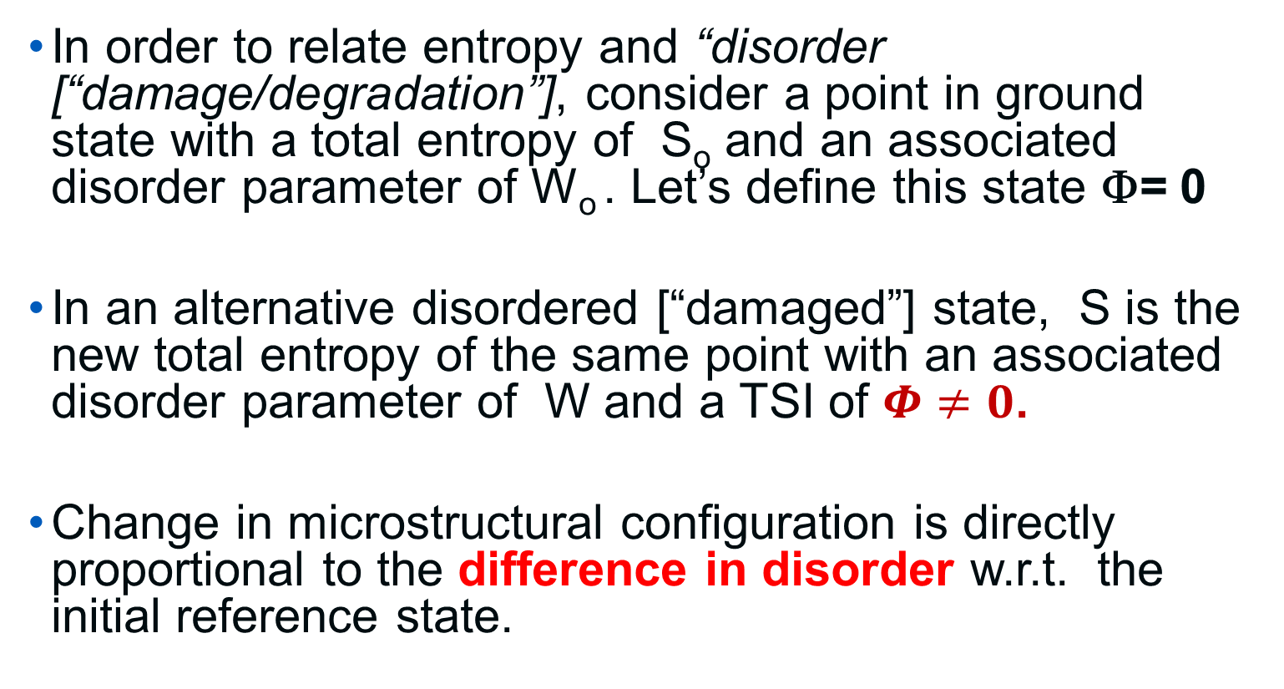
Thermodynamic State Index (TSI), Φ
In order to relate entropy and “disorder [“damage/degradation”], consider a point in ground state with a total entropy of S_{o} and an associated disorder parameter of W_{o} . Let’s define this state Φ= 0
In an alternative disordered [“damaged”] state, S is the new total entropy of the same point with an associated disorder parameter of W and a TSI of $Φ≠0$.
Change in microstructural configuration is directly proportional to the difference in disorder w.r.t. the initial reference state.

Slide 17
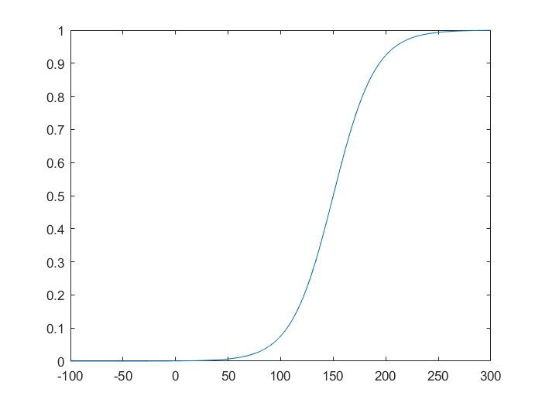

Thermodynamic State Index (TSI): Φ
Φ$=f\left[\frac{W−W_{o}}{W}\right]=[1−e^{−\frac{(s−s_{o})m_{s}}{kN_{o}}}$]
TSI is the normalized form of the second law of thermodynamics.

Slide 18
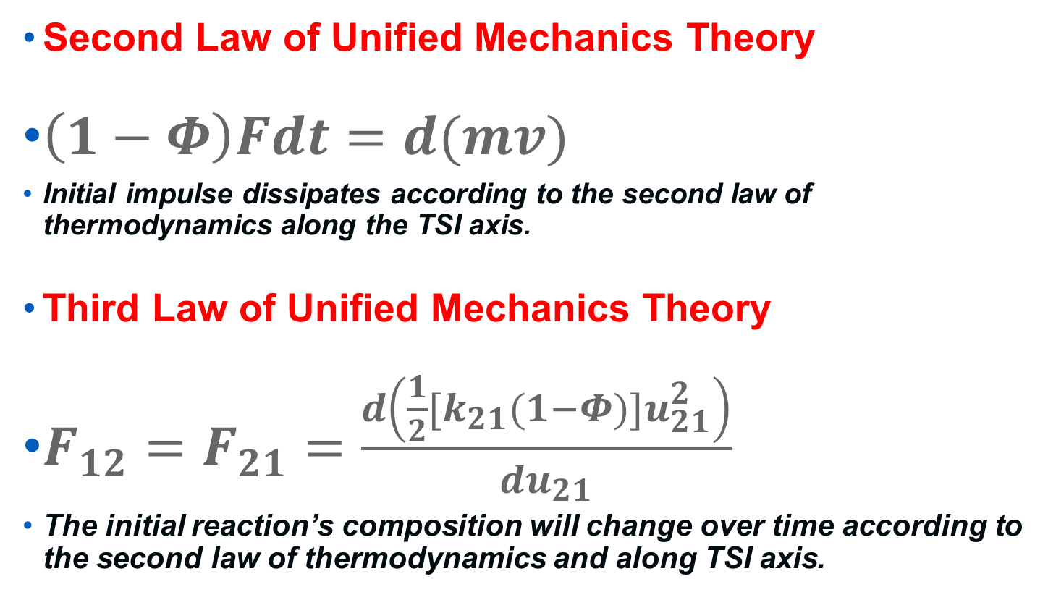
Laws of Unified Mechanics Theory
Second Law of Unified Mechanics Theory
$\left(1−Φ\right)Fdt=d(mv)$
Initial impulse dissipates according to the second law of thermodynamics along the TSI axis.
Third Law of Unified Mechanics Theory
$F_{12}=F_{21}=\frac{d\left({\frac{1}{2}[k}_{21}(1−Φ)]u_{21}^{2}\right)}{{du}_{21}}$
The initial reaction’s composition will change over time according to the second law of thermodynamics and along TSI axis.

Slide 19



Coordinates in Unified Mechanics Theory
Y
Thermodynamic State Index (TSI)
0.99
=
5 year old
Stage4 cancer
100 year old
0
5 years old
X
100 years old
Z
Time

Slide 20
Why is TSI Essential
TSI axis is linearly independent.
Space-Time can progress without any change in TSI axis coordinate, e.g. at zero Kelvin.
Space coordinates can change without any change in TSI axis coordinate, e.g. rigid body motion
But if TSI coordinate changes, Space-Time MUST change. [Entropy is arrow of time, Prof. Arthur Eddington]
TSI coordinate cannot be represented in Space-Time.
Derivative of Space and Time w.r.t TSI cannot be zero

Slide 21
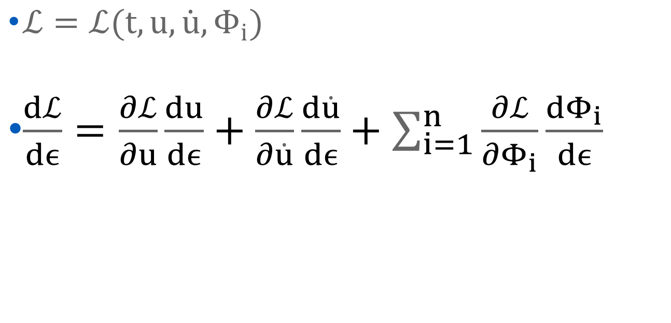

Lagrangian in Unified Mechanics Theory
$ℒ=ℒ(t,u,\dot{u},Φ_{i})$
$\frac{dℒ}{dϵ}=\frac{∂ℒ}{∂u}\frac{du}{dϵ}+\frac{∂ℒ}{∂\dot{u}}\frac{d\dot{u}}{dϵ}+\sum_{i=1}^{n}{\frac{∂ℒ}{∂Φ_{i}}\frac{dΦ_{i}}{dϵ}}$
New additional derivatives

Slide 22

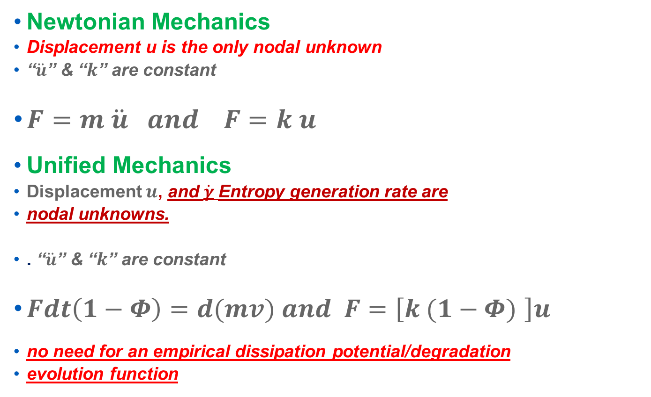

Unified Mechanics vs. Newtonian Mechanics
Newtonian Mechanics
Displacement u is the only nodal unknown
“$\ddot{u}$” & “$k$” are constant
$F=m \ddot{u} and F=k u$
Unified Mechanics
Displacement $u$, and $\dot{γ}$Entropy generation rate are
nodal unknowns.
. “$\ddot{u}$” & “$k$” are constant
$Fdt\left(1−Φ\right)=d(mv) and F=\left[k (1−Φ) \right]u$
no need for an empirical dissipation potential/degradation
evolution function
U, $\dot{γ}$
P

Slide 23
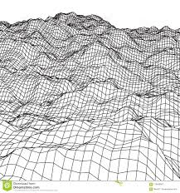
Definition of Thermodynamic State Index
Energy Topology
TSI =0
TSI =1
All organic and inorganic systems exist on an energy topology.

Slide 24
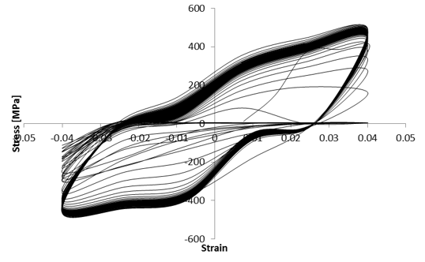
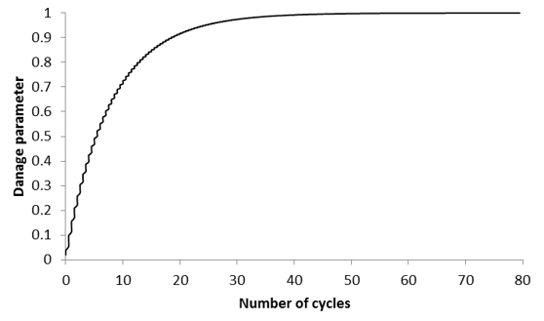
Fatigue Loading on A-36 Steel–
TSI Calculated from Experiment

Slide 25
W. Egner , P. Sulich, S. Mrozinski , H. Egner, Modelling thermo-mechanical cyclic behavior of P91 steel, Int. Journal of Plasticity 135 (2020) 102820
Compared Chaboche-Lemaitre ductile damage model with UMT against test data
“The results indicate that dissipation-based fatigue damage modeling [UMT] leads to better fatigue behavior predictions.”
17 versus 0 parameters

Slide 26
Deriving Thermodynamic Fundamental Equation
Very High Cycle Fatigue- [Elastic zone]
Ultrasonic Vibrations at 20KHz
A656 grade steel
ASTM standard sample

Slide 27
Deriving Thermodynamic Fundamental Equation
Entropy generation - very high cycle fatigue [metals]
Lattice vacancy reconfiguration
Vacancy formation
Vacancy diffusion
Thermal conduction
Internal scattering (fast-moving dislocations and phonon drag)
Microplasticity
Phase change

Slide 28
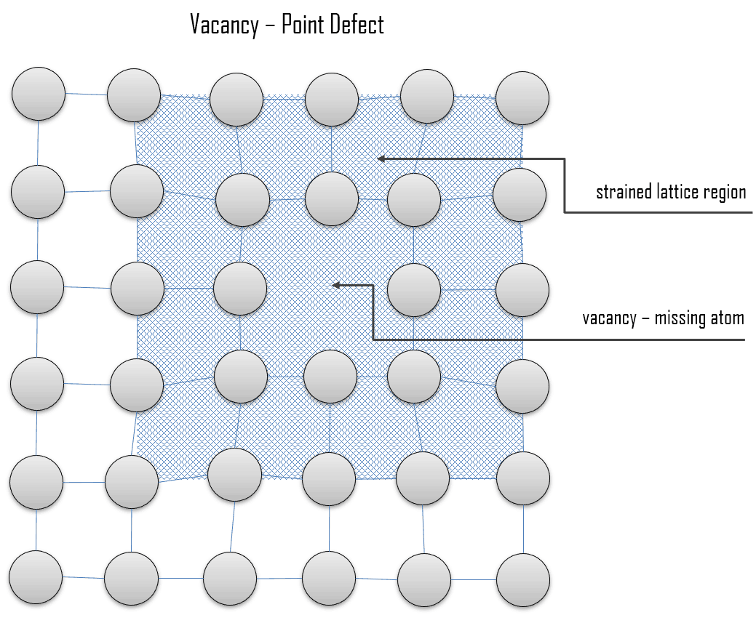
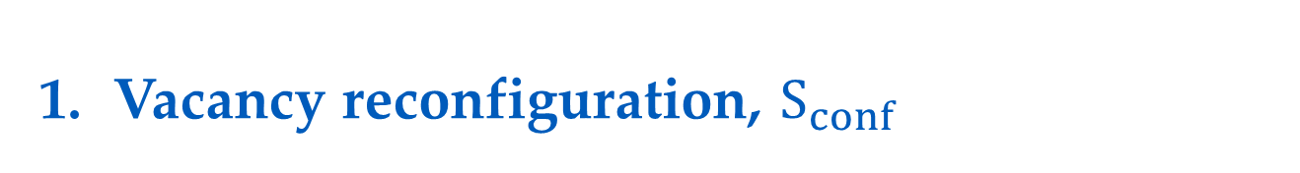
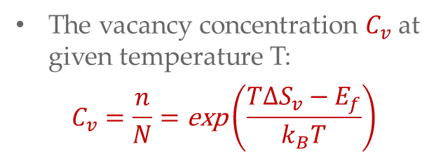
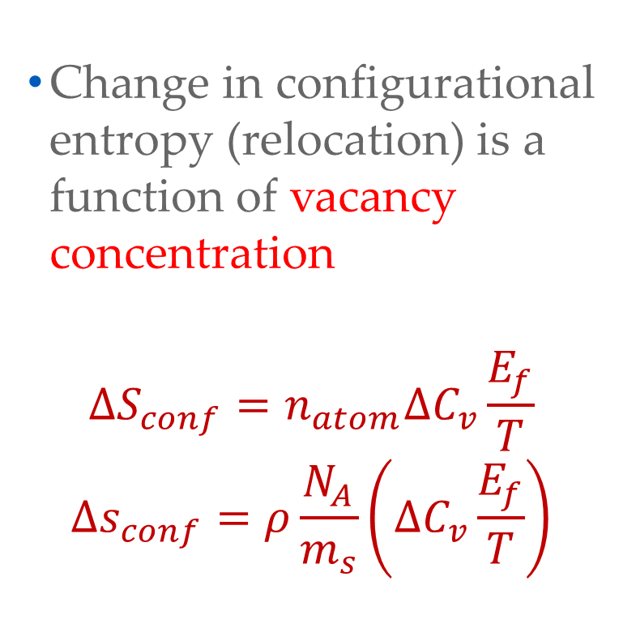
Vacancy reconfiguration, $S_{conf}$
Entropy generation -very high cycle fatigue [metals]
Change in configurational entropy (relocation) is a function of vacancy concentration
$$∆S_{conf}=n_{atom}∆C_{v}\frac{E_{f}}{T}$$
$$∆s_{conf}=ρ\frac{N_{A}}{m_{s}}\left(∆C_{v}\frac{E_{f}}{T}\right)$$
The vacancy concentration $C_{v}$ at given temperature T:
$$C_{v}=\frac{n}{N}=\text{exp}\left(\frac{T{∆S}_{v}−E_{f}}{k_{B}T}\right)$$

Slide 29
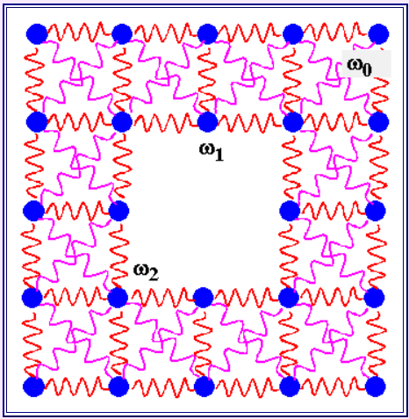
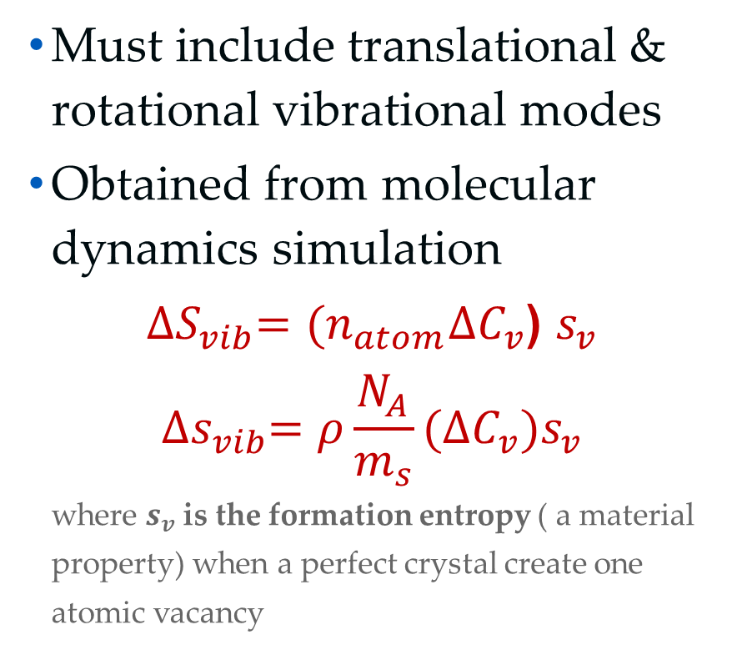
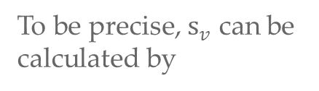
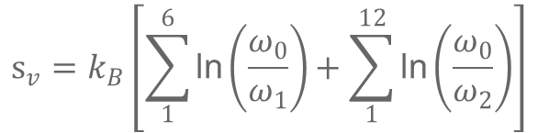
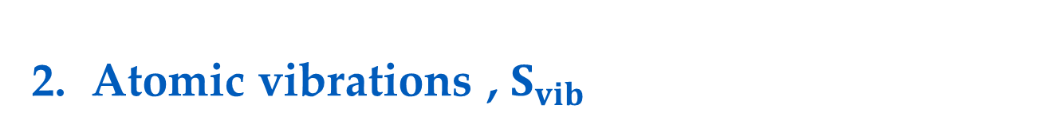
Atomic vibrations , $S_{vib}$
Entropy generation -very high cycle fatigue [metals]
Must include translational & rotational vibrational modes
Obtained from molecular dynamics simulation
${∆S}_{vib}=(n_{atom}∆C_{v}$) $s_{v}$
$${∆s}_{vib}=ρ\frac{N_{A}}{m_{s}}(∆C_{v})s_{v}$$
where $s_{v}$is the formation entropy ( a material
property) when a perfect crystal create one
atomic vacancy
To be precise, $s_{v}$ can be
calculated by
$$s_{v}=k_{B}\left[\sum_{1}^{6}{\text{ln}\left(\frac{ω_{0}}{ω_{1}}\right)}+\sum_{1}^{12}{\text{ln}\left(\frac{ω_{0}}{ω_{2}}\right)}\right]$$

Slide 30

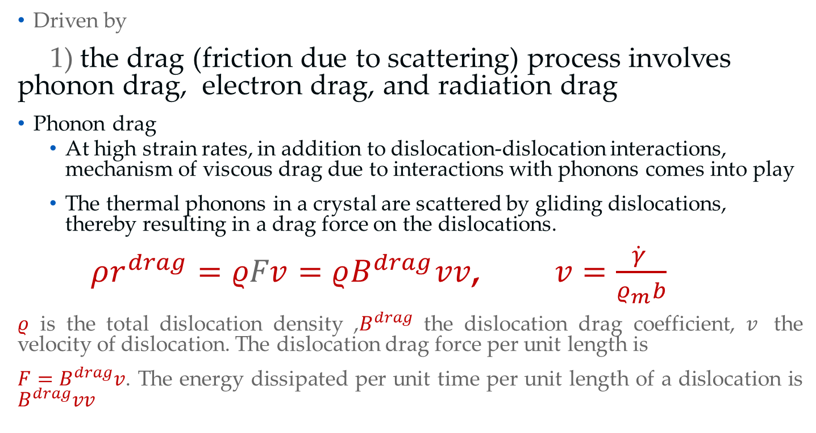
Entropy generation- very high cycle fatigue [metals]
Internal friction [scattering], $S_{r}$
Driven by
1) the drag (friction due to scattering) process involves phonon drag, electron drag, and radiation drag
Phonon drag
  At high strain rates, in addition to dislocation-dislocation interactions, mechanism of viscous drag due to interactions with phonons comes into play
  The thermal phonons in a crystal are scattered by gliding dislocations, thereby resulting in a drag force on the dislocations.
  $ρr^{drag}=ρFv=ρB^{drag}vv$, $v=\frac{\dot{γ} }{ρ_{m}b}$
$ρ$ is the total dislocation density ,$B^{drag}$ the dislocation drag coefficient, $v$ the velocity of dislocation. The dislocation drag force per unit length is
$F=B^{drag}v$. The energy dissipated per unit time per unit length of a dislocation is $B^{drag}vv$

Slide 31

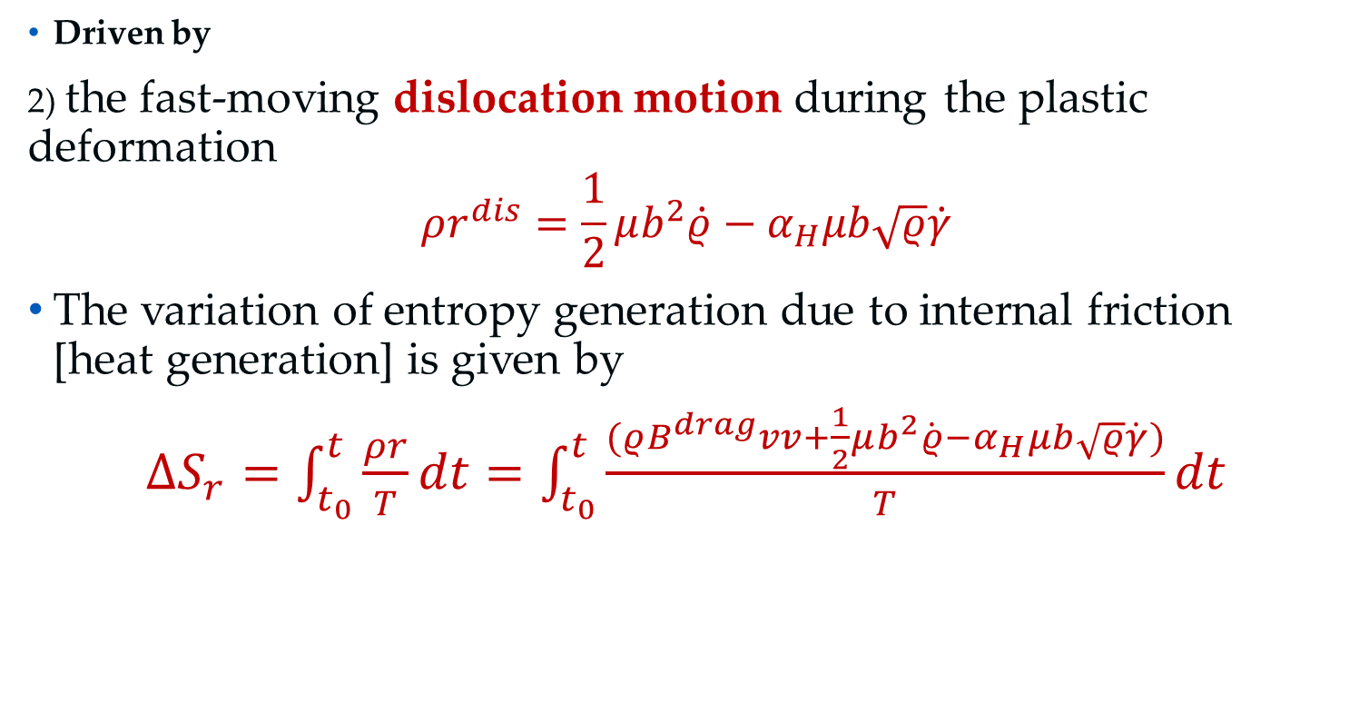
Entropy generation- very high cycle fatigue [metals]
Internal friction [scattering], , $S_{r}$
Driven by
2) the fast-moving dislocation motion during the plastic deformation
$$ρr^{dis}=\frac{1}{2}μb^{2}\dot{ρ}−α_{H}μb\sqrt{ρ}\dot{γ}$$
The variation of entropy generation due to internal friction [heat generation] is given by
$∆S_{r}=\int_{t_{0}}^{t}{\frac{ρr}{T}dt}=\int_{t_{0}}^{t}{\frac{(ρB^{drag}vv+\frac{1}{2}μb^{2}\dot{ρ}−α_{H}μb\sqrt{ρ}\dot{γ})}{T}dt}$
Phonon drag

Slide 32
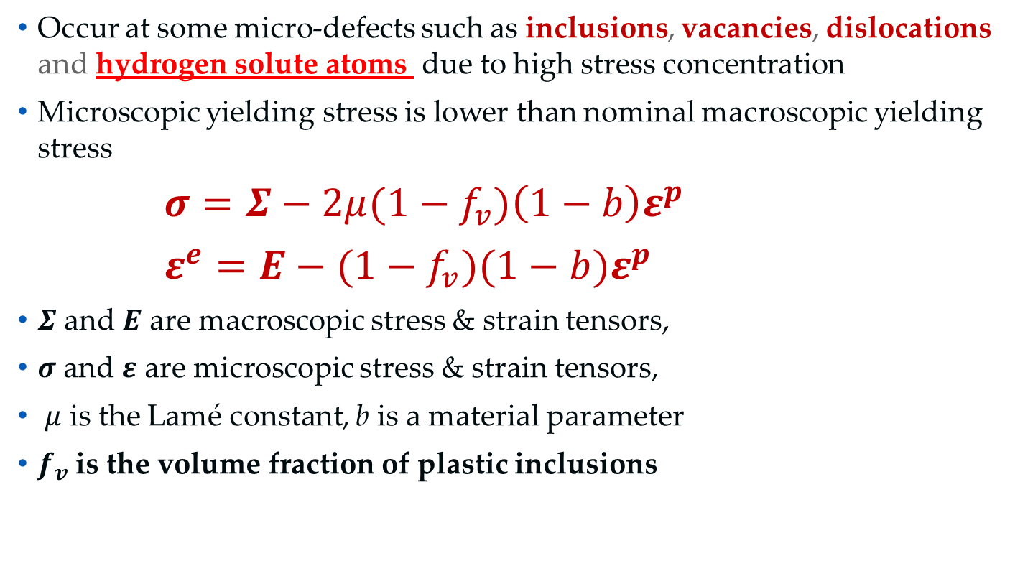

Entropy generation- very high cycle fatigue [metals]
Micro-plasticity, $S_{MP}$
Occur at some micro-defects such as inclusions, vacancies, dislocations and hydrogen solute atoms due to high stress concentration
Microscopic yielding stress is lower than nominal macroscopic yielding stress
$σ=Σ−2μ(1−f_{v})\left(1−b\right)ε^{p}$
$ε^{e}=E−(1−f_{v})(1−b)ε^{p}$
$Σ$ and $E$ are macroscopic stress & strain tensors,
$σ$ and $ε$ are microscopic stress & strain tensors,
$μ$ is the Lamé constant, b is a material parameter
$f_{v}$ is the volume fraction of plastic inclusions
Two-scale model

Slide 33
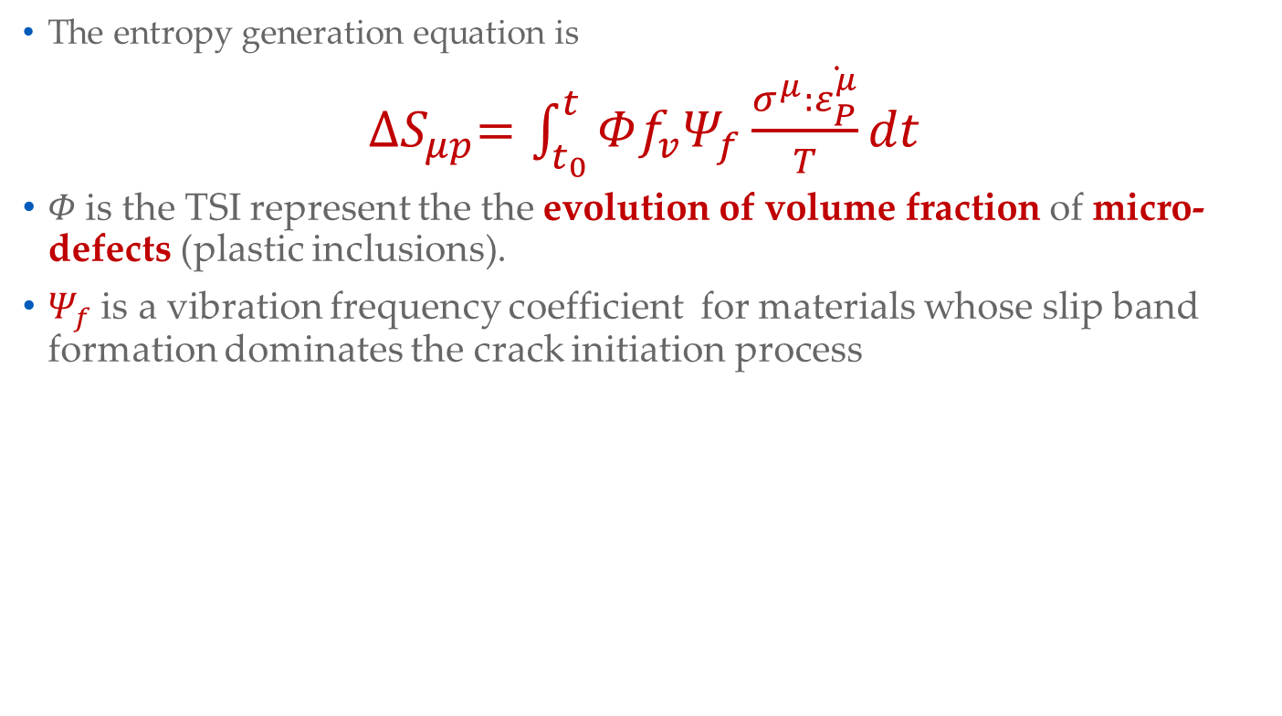

Entropy generation- very high cycle fatigue [metals]
Micro-plasticity, $S_{μp}$
The entropy generation equation is
${∆S}_{μp}=\int_{t_{0}}^{t}{Φf_{v}Ψ_{f}\frac{σ^{μ}:\dot{ε_{P}^{μ}}}{T}dt}$
$Φ$is the TSI represent the the evolution of volume fraction of micro-defects (plastic inclusions).
$Ψ_{f}$ is a vibration frequency coefficient for materials whose slip band formation dominates the crack initiation process
Slip bands in ferrite grains on the surface of the specimen

Slide 34
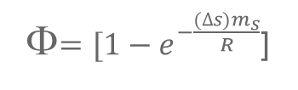
mechanical loading is ultrasonic vibration 20 KHz
TSI evolution
Φ$=[1−e^{−\frac{(∆s)m_{s}}{R}}$]
Accumulated entropy production versus number of cycles under various stress amplitude. The constant entropy production at failure is called “Fatigue fracture entropy (FFE)”, which is a material property regardless of the test frequency, loading type, geometry of the specimen, or stress state.

Slide 35
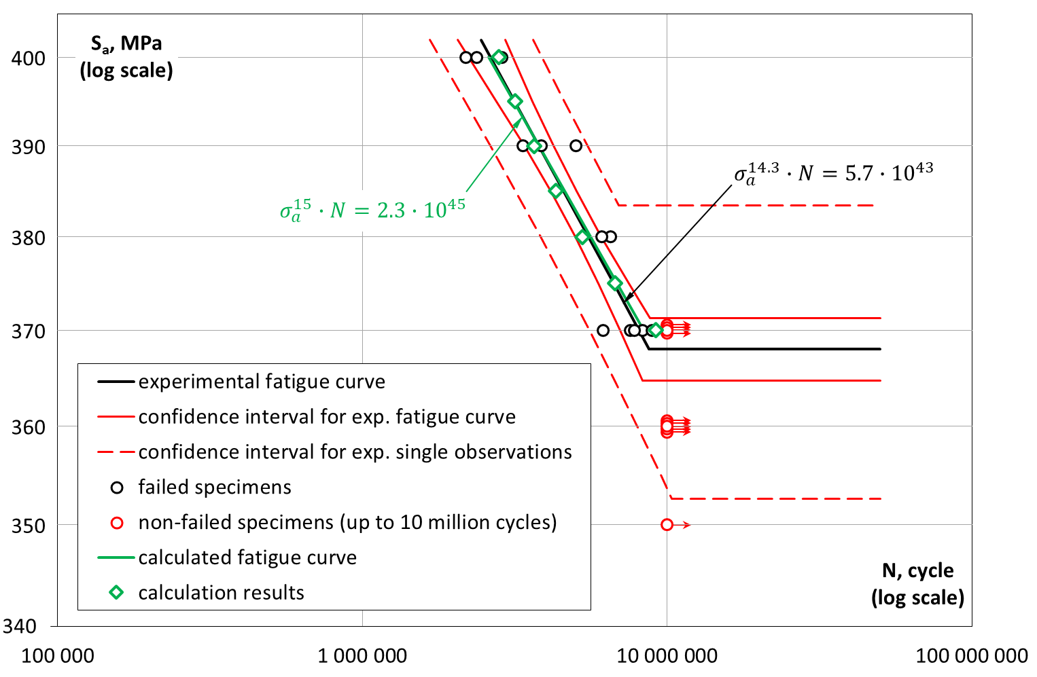
SN curve, Experimental vs UMT

Slide 36
Deriving Thermodynamic Fundamental Equation
Corrosion of steel in salty water

Slide 37
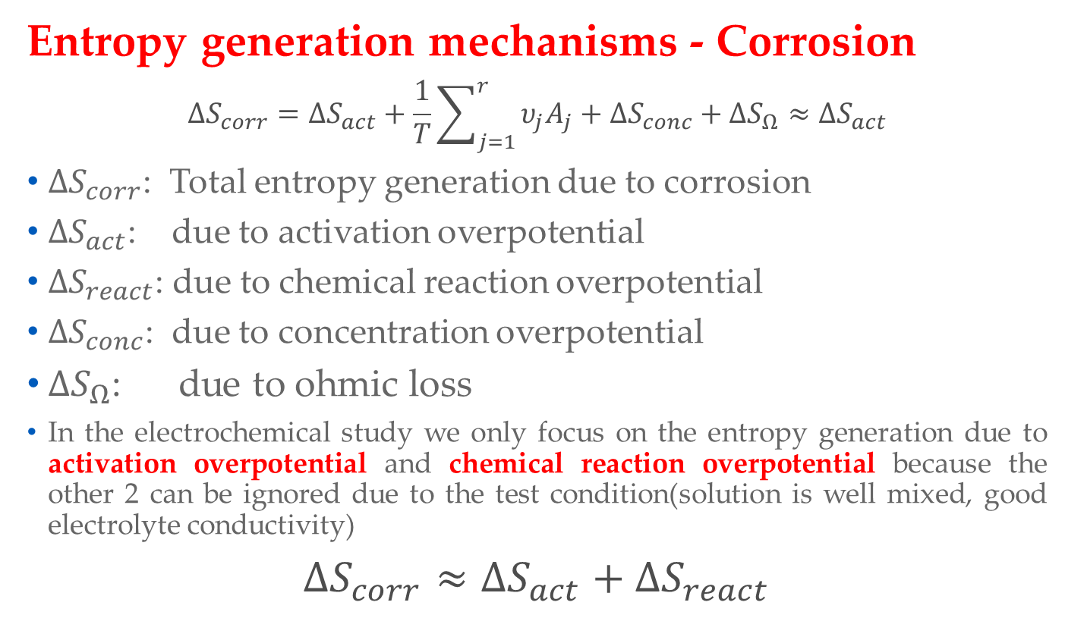
Deriving Thermodynamic Fundamental Equation
Entropy generation mechanisms - Corrosion
$$∆S_{corr}=∆S_{act}+\frac{1}{T}\sum_{j=1}^{r}{υ_{j}A_{j}}+∆S_{conc}+∆S_{Ω}≈∆S_{act}$$
$∆S_{corr}$: Total entropy generation due to corrosion
$∆S_{act}$: due to activation overpotential
$∆S_{react}$: due to chemical reaction overpotential
$∆S_{conc}$: due to concentration overpotential
$∆S_{Ω}$: due to ohmic loss
In the electrochemical study we only focus on the entropy generation due to activation overpotential and chemical reaction overpotential because the other 2 can be ignored due to the test condition(solution is well mixed, good electrolyte conductivity)
$∆S_{corr}$ $≈∆S_{act}+∆S_{react}$

Slide 38

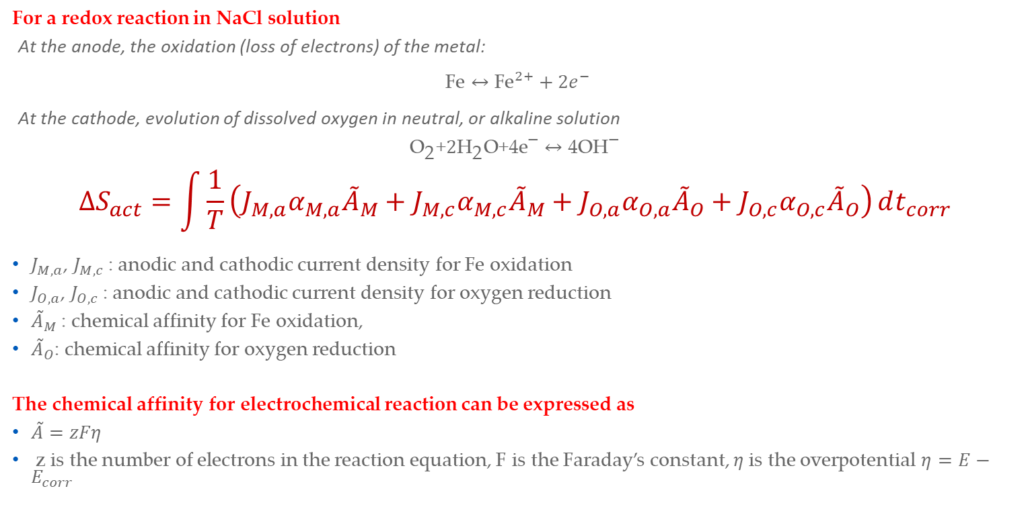

Entropy generation -electrochemical corrosion
Activation overpotential, $S_{act}$
For a redox reaction in NaCl solution
At the anode, the oxidation (loss of electrons) of the metal:
$\text{Fe}↔{\text{Fe}}^{2+}+2e^{−}$
At the cathode, evolution of dissolved oxygen in neutral, or alkaline solution
$${\text{O}}_{\text{2}}\text{+}{\text{2}\text{H}}_{\text{2}}\text{O}\text{+4}{\text{e}}^{\text{−}}↔\text{4}{\text{OH}}^{\text{−}}$$
$$∆S_{act}=\int{\frac{1}{T}\left(J_{M,a}α_{M,a}{\tilde{A}}_{M}+J_{M,c}α_{M,c}{\tilde{A}}_{M}+J_{O,a}α_{O,a}{\tilde{A}}_{O}+J_{O,c}α_{O,c}{\tilde{A}}_{O}\right)}dt_{corr}$$
$J_{M,a}$, $J_{M,c}$: anodic and cathodic current density for Fe oxidation
$J_{O,a}$, $J_{O,c}$: anodic and cathodic current density for oxygen reduction
${\tilde{A}}_{M}$: chemical affinity for Fe oxidation,
${\tilde{A}}_{O}$: chemical affinity for oxygen reduction
The chemical affinity for electrochemical reaction can be expressed as
$\tilde{A}=zFη$
z is the number of electrons in the reaction equation, F is the Faraday’s constant, $η$ is the overpotential $η=E−E_{corr}$
$$α_{M,a}+α_{M,c}=1$$
$$α_{O,a}+α_{O,c}=1$$

Slide 39

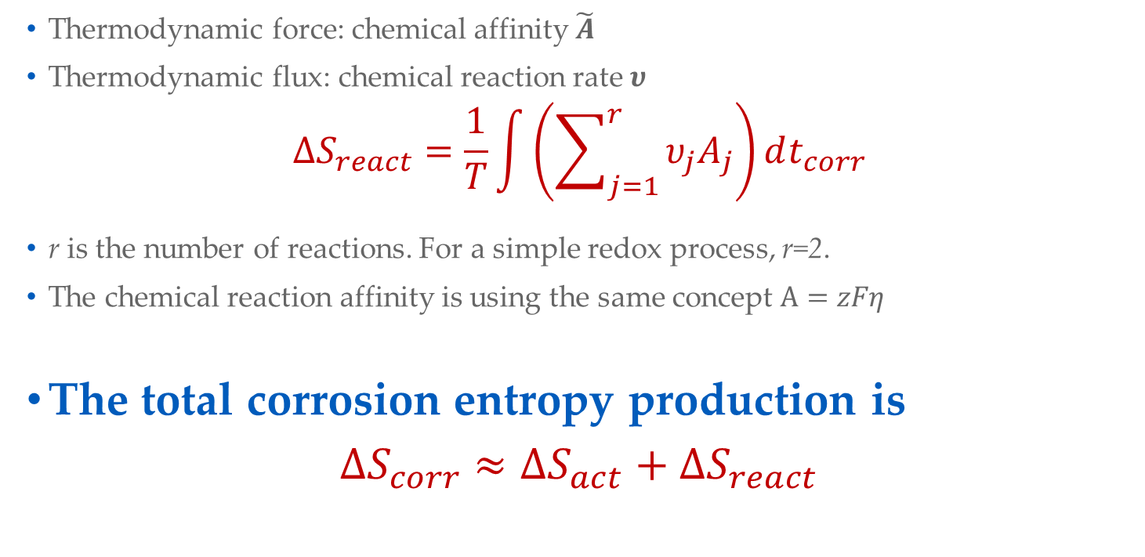
Entropy generation -electrochemical corrosion
Chemical reaction overpotential, $S_{act}$
Thermodynamic force: chemical affinity $\tilde{A}$
Thermodynamic flux: chemical reaction rate $υ$
$$∆S_{react}=\frac{1}{T}\int{\left(\sum_{j=1}^{r}{υ_{j}A_{j}}\right)}dt_{corr}$$
r is the number of reactions. For a simple redox process, r=2.
The chemical reaction affinity is using the same concept $A=zFη$
The total corrosion entropy production is
$∆S_{corr}$ $≈∆S_{act}+∆S_{react}$

Slide 40
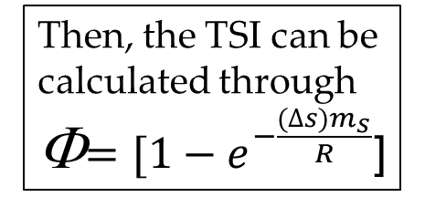
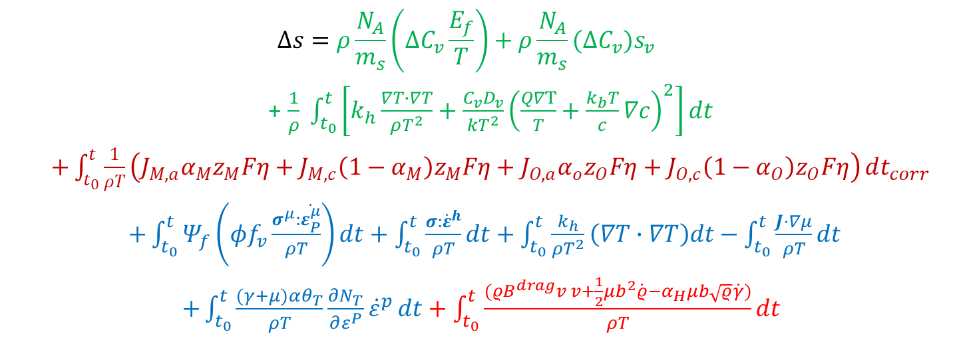
Thermodynamic Fundamental Equation
$$Δs=ρ\frac{N_{A}}{m_{s}}\left(∆C_{v}\frac{E_{f}}{T}\right)+ρ\frac{N_{A}}{m_{s}}(∆C_{v})s_{v}$$
+ $\frac{1}{ρ} \int_{t_{0}}^{t}{\left[k_{h}\frac{∇T∙∇T}{ρT^{2}}+\frac{C_{v}D_{v}}{kT^{2}}{\left(\frac{Q∇T}{T}+\frac{k_{b}T}{c}∇c\right)}^{2}\right]dt}$
$+\int_{t_{0}}^{t}{\frac{1}{ρT}\left(J_{M,a}α_{M}z_{M}Fη+J_{M,c}\left(1−α_{M}\right)z_{M}Fη+J_{O,a}α_{o}z_{O}Fη+J_{O,c}\left(1−α_{O}\right)z_{O}Fη\right)}dt_{corr}$
$+\int_{t_{0}}^{t}{Ψ_{f}\left(φf_{v}\frac{σ^{μ}:\dot{ε_{P}^{μ}}}{ρT}\right)dt}+\int_{t_{0}}^{t}{\frac{σ:{\dot{ε}}^{h}}{ρT}dt}+\int_{t_{0}}^{t}{\frac{k_{h}}{{ρT}^{2}}\left(∇T∙∇T\right)dt}−\int_{t_{0}}^{t}{\frac{J⋅∇μ}{ρT}}dt$
$+\int_{t_{0}}^{t}{\frac{(γ+μ)αθ_{T}}{ρT}\frac{∂N_{T}}{∂ε^{P}}{\dot{ε}}^{p}}dt+\int_{t_{0}}^{t}{\frac{(ρB^{drag}v v+\frac{1}{2}μb^{2}\dot{ρ}−α_{H}μb\sqrt{ρ}\dot{γ})}{ρT}dt}$
Irreversible entropy production due to
Vacancy configuration, atomic vibration, and vacancy diffusion
Corrosion
Hydrogen enhanced mechanisms (micro-plasticity, hydrogen dilatation, thermal conduction, hydrogen transport, coupling source
Internal frictions
Then, the TSI can be calculated through
Φ$=[1−e^{−\frac{(∆s)m_{s}}{R}}$]

Slide 41
Verifications
Hsiao Wei Lee, Hamidreza Fakhri, Ravi Ranade, Cemal Basaran, Halina Egner, Adam Lipski, Michał Piotrowski, Stanisław Mroziński, Modeling fatigue of pre-corroded body-centered cubic metals with unified mechanics theory, Materials & Design, 224, 2022, 111383,
Hsiao Wei Lee, Cemal Basaran, Halina Egner, Adam Lipski, Michał Piotrowski, Stanisław Mroziński, Noushad Bin Jamal M, Chebolu Lakshmana Rao, Modeling ultrasonic vibration fatigue with unified mechanics theory, International Journal of Solids and Structures,236–237, 2022, 111313,
Hsiao Wei Lee, Milos Djukic, Cemal Basaran, Modeling fatigue life and hydrogen embrittlement of bcc steel with unified mechanics theory, International Journal of Hydrogen Energy, March 2023, ISSN 0360-3199, https://doi.org/10.1016/j.ijhydene.2023.02.110

Slide 42
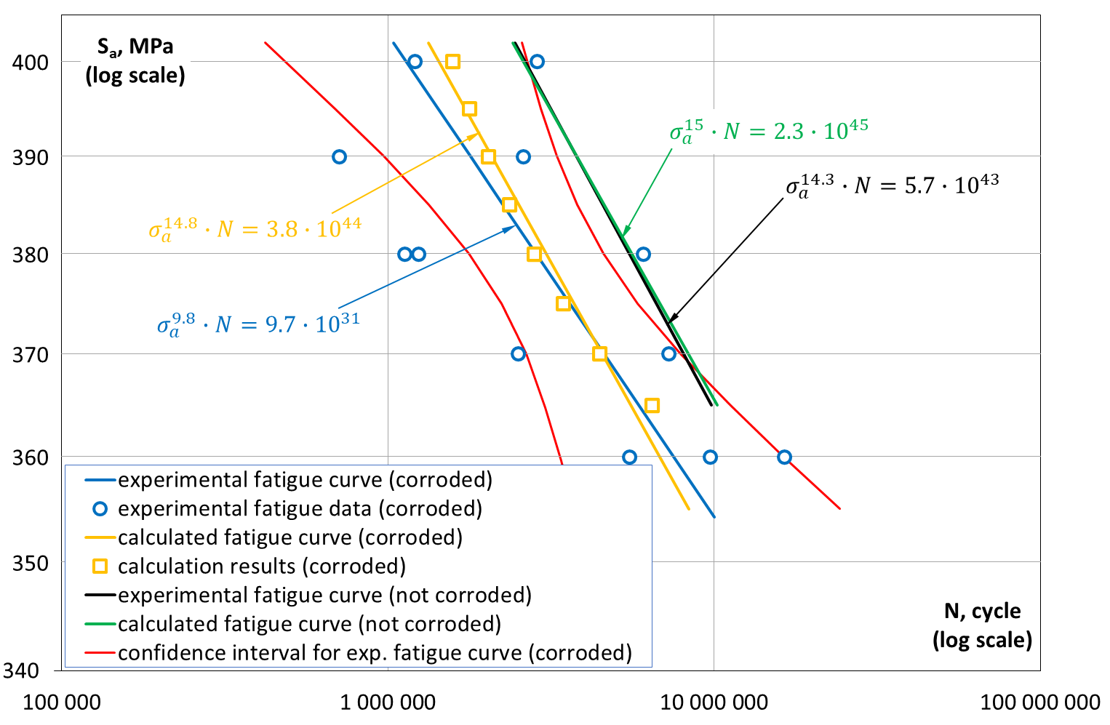
SN curve, Experimental vs UMT (corroded)

Slide 43
SN curve, UMT (hydrogen-charged)

Slide 44


Slide 45
CONCLUSIONS
Space-Time-TSI coordinate system is essential to define any organic or inorganic point in space.
Unified Mechanics Theory Laws govern the response of any system during its lifetime from the initial point till “end”
Unified Mechanics Theory requires analytical derivation of the thermodynamic fundamental equation of the material/structure which must include all mechanisms that generate entropy under the given load, (i.e. mechanical, thermal, chemical, electrical, radiation, corrosion etc.) towards the pre-defined failure.

Slide 46

Thank you for listening
QUESTIONS

